Slide 1

NextHikes IT Solutions: EDA for Real Estate Pricing
Exploratory Data Analysis (EDA) is vital for understanding real estate pricing. We aim to unveil the dynamics of house valuation in a dynamic market. This presentation will cover key insights and next steps.
AK
by Abhinav Tiwari

Slide 2
Understanding the Problem: House Valuation in a Dynamic Market
Dynamic Market
Multifaceted Challenge
Residential real estate is always changing. This makes pricing a challenge.
Determining an optimal price is complex. Many variables impact value.
We need to identify and understand the key variables. This will help us determine competitive prices.

Slide 3

Data Acquisition and Cleaning: Preparing for Analysis
Data Sources
1
Gather data from multiple sources. Include public records and market data.
2
Cleaning Process
Handle missing values and outliers carefully. Ensure data is consistent and accurate.
Preparation
3
Transform data for analysis. Create relevant features for modeling.
Acquiring and cleaning data are essential first steps. This ensures reliable analysis.

Slide 4

Key Features and Initial Insights: A Statistical Overview
1
Descriptive Stats
2
Visualizations
Calculate mean, median, and standard deviation. Understand the distribution of key features.
Use histograms and box plots to identify outliers. Visualize the distribution of house prices.
3
Initial Findings
Identify the most important features impacting price. These may include size and location.
Statistical overviews provide valuable initial insights. This helps us understand the data.

Slide 5
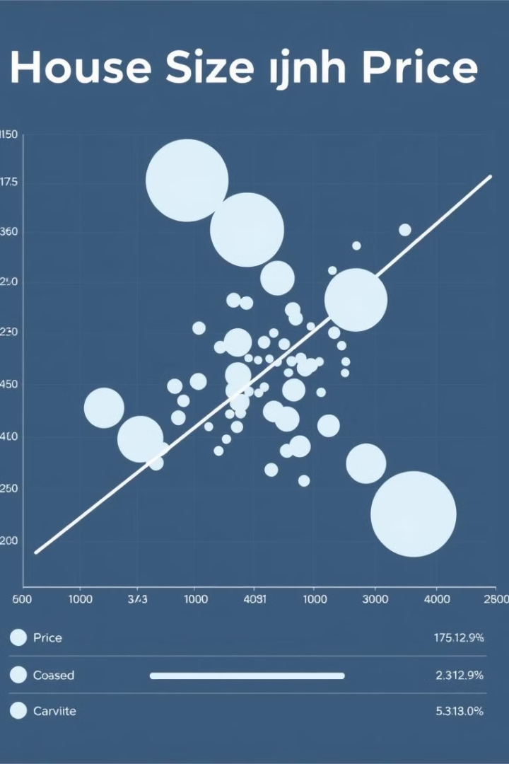



Unveiling Correlations: Feature Relationships and Market Trends
Correlation Matrix
Calculate correlations between features. Identify strong positive and negative relationships.
Scatter Plots
Visualize relationships between price and features. Look for linear and non-linear trends.
Market Trends
Analyze how features impact price over time. Identify seasonal and economic influences.
Feature relationships are crucial. Understanding market trends enhances valuation accuracy.

Slide 6
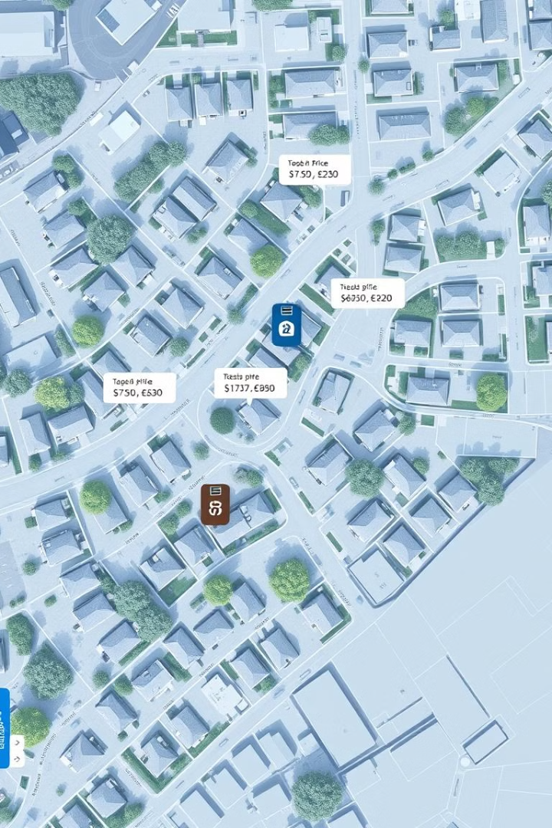
Geographical Analysis: Location, Location, Location!
Mapping Prices
Proximity Analysis
Visualize average prices by neighborhood. Identify price hotspots and undervalued areas.
Measure distance to amenities and schools. Determine the impact on house prices.
Location Scores
Create a location score based on key factors. Use this to adjust price estimates.
Location is a key determinant of real estate value. This analysis helps us understand its impact.

Slide 7




Predictive Modeling: Building a Baseline Price Estimator
Model Selection
Model Training
Evaluation
Choose a suitable regression model. Consider linear regression or more advanced methods.
Train the model using historical data. Optimize parameters to improve accuracy.
Evaluate model performance using metrics. These include R-squared and RMSE.
Predictive modeling helps estimate baseline prices. This can be improved with more data and features.

Slide 8



Conclusions and Next Steps: Towards a Comprehensive Valuation Model
2
Limitations
1
Key Findings
Recommendations
3
We have identified key factors affecting real estate prices. The next steps involve refining our valuation model.

